Slide 1

Exam AZ-303: Microsoft Azure Architect Technologies Crash Course
Tim Warner

Slide 2


Tim Warner
Based in Nashville, TN, US
MCT, MVP
Twitter: @TechTrainerTim
Badge: timw.info

Slide 3
Day 1 of 2 Agenda
Introduction
Identity design
Storage design
IaaS design
Monitoring design
Exam AZ-303 strategy

Slide 4
Day 2 of 2 Agenda
Workload migration/BCDR
Network load balancing
Governance
Application architecture design
Database platform design
Exam AZ-303 Strategy

Slide 5
Course Materials
timw.info/az303

Slide 6
A Different Kind of Training
Let's avoid slide show fatigue
We'll learn by doing – at least 80 percent demo
Case study approach
This is an expert certification, so we will move quickly and assume intermediate-level Azure skills
5-minute break at midpoint
I’m here to answer your questions – take advantage of this!
Use the Q&A panel

Slide 7

Session Recordings

Slide 8
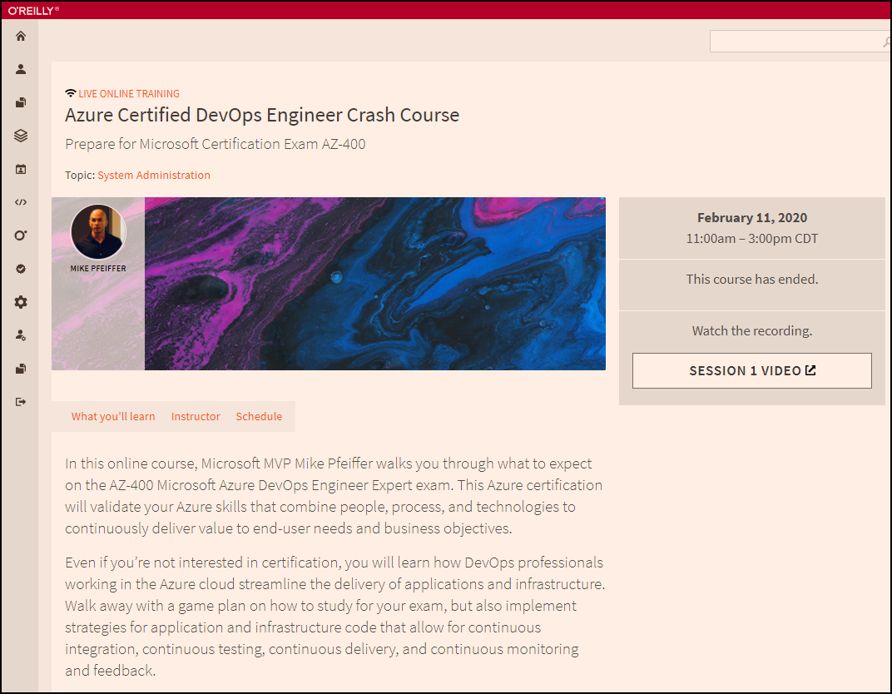
Session Recordings

Slide 9

Session Recordings

Slide 10
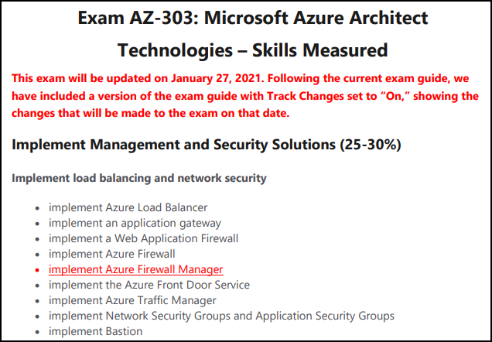
Azure Architect 2021 Changes

Slide 11
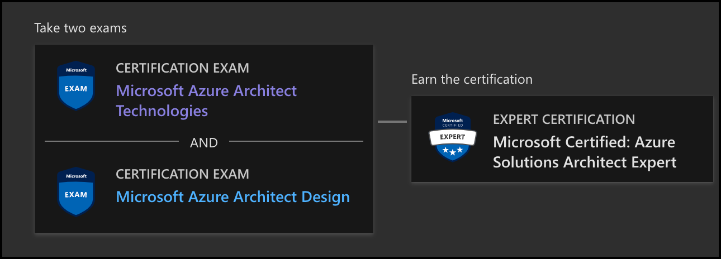
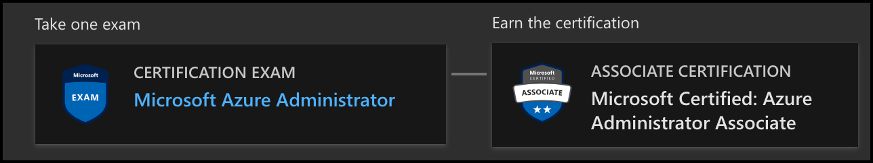
Azure Architect Facts and Tips
AZ-303
AZ-304
AZ-104

Slide 12
Tim's Certification Study Pyramid
Interdependence
Content knowledge
Practical application
Test-taking skills

Slide 13
Thank you!
Course materials: timw.info/az303
Twitter: @TechTrainerTim
Work: timw.info/ps
Web: TechTrainerTim.com

Slide 14
Authentication

Slide 15

Azure Subscriptions

Slide 16

Azure Management Scopes
/ Tenant root
Inheritence:
RBAC
Policy
No inheritence:
Tags

Slide 17

Hybrid Identity

Slide 18

Passthrough Authentication

Slide 19

Seamless Single Sign-on

Slide 20
Azure Storage

Slide 21
Storage Account Replication
1
3
3
2
LRS
ZRS

Slide 22
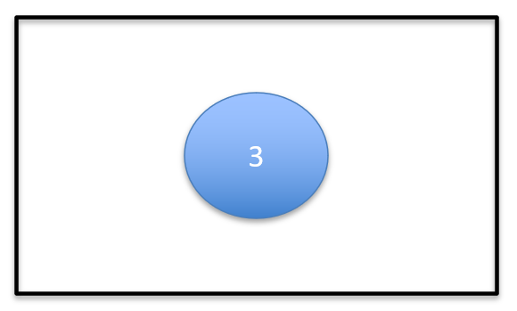
Storage Account Replication
1
3
1
3
2
2
GRS / RA-GRS

Slide 23
Storage Account Replication
1
3
1
3
2
2
GZRS / RA-GZRS

Slide 24
Azure Compute

Slide 25
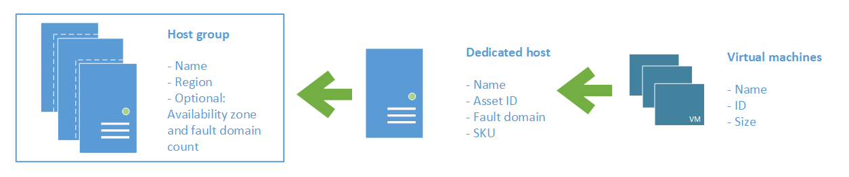
Azure VM Dedicated Host

Slide 26
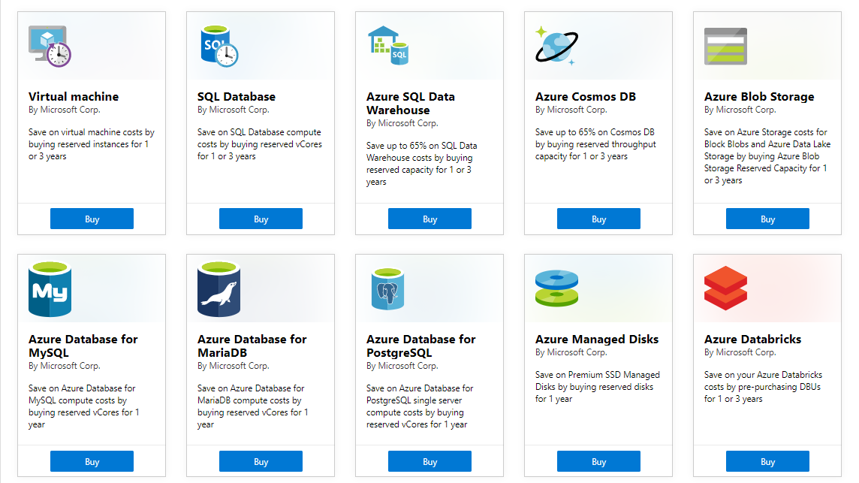
Azure Reservations

Slide 27

VM Scale Sets

Slide 28
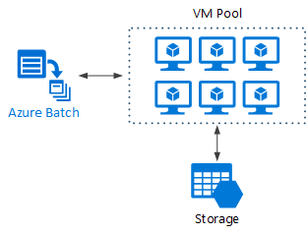
Azure Batch

Slide 29

Availability Set

Slide 30

Availability Zone

Slide 31






Azure App Service
Web Apps
Web Apps for Containers
API Management
Functions
Logic Apps

Slide 32



Running Containers in Azure
Azure Container Instances
Azure Container Registry
Azure Kubernetes Service (AKS)

Slide 33


Docker Lifecycle
https://timw.info/89a04

Slide 34
Migration and Disaster Recovery

Slide 35
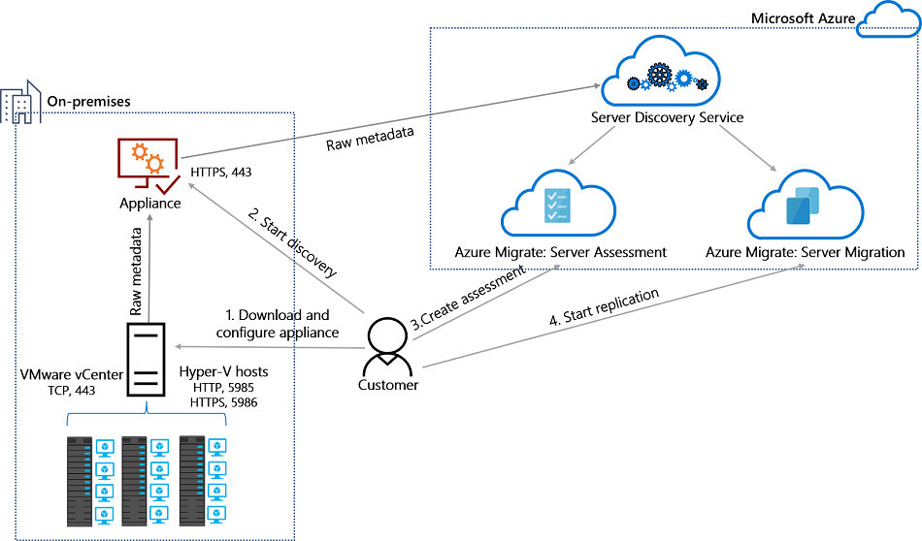
Azure Migrate

Slide 36

Azure Backup

Slide 37

Azure Site Recovery

Slide 38
Load Balancing

Slide 39

VM Networking

Slide 40

Load Balancing

Slide 41

VNet Peering

Slide 42

Hybrid Networking

Slide 43

Network Virtual Appliance

Slide 44

Azure Load Balancer

Slide 45

Application Gateway

Slide 46

Traffic Manager

Slide 47

Front Door Service

Slide 48
Governance

Slide 49

Tenant vs. Subscription

Slide 50
Azure Management Scopes
/ Tenant Root

Slide 51
App Architecture

Slide 52


Docker Container Lifecycle
https://timw.info/3635f

Slide 53

Event Architecture

Slide 54
Data Platform

Slide 55

Always Encrypted

Slide 56
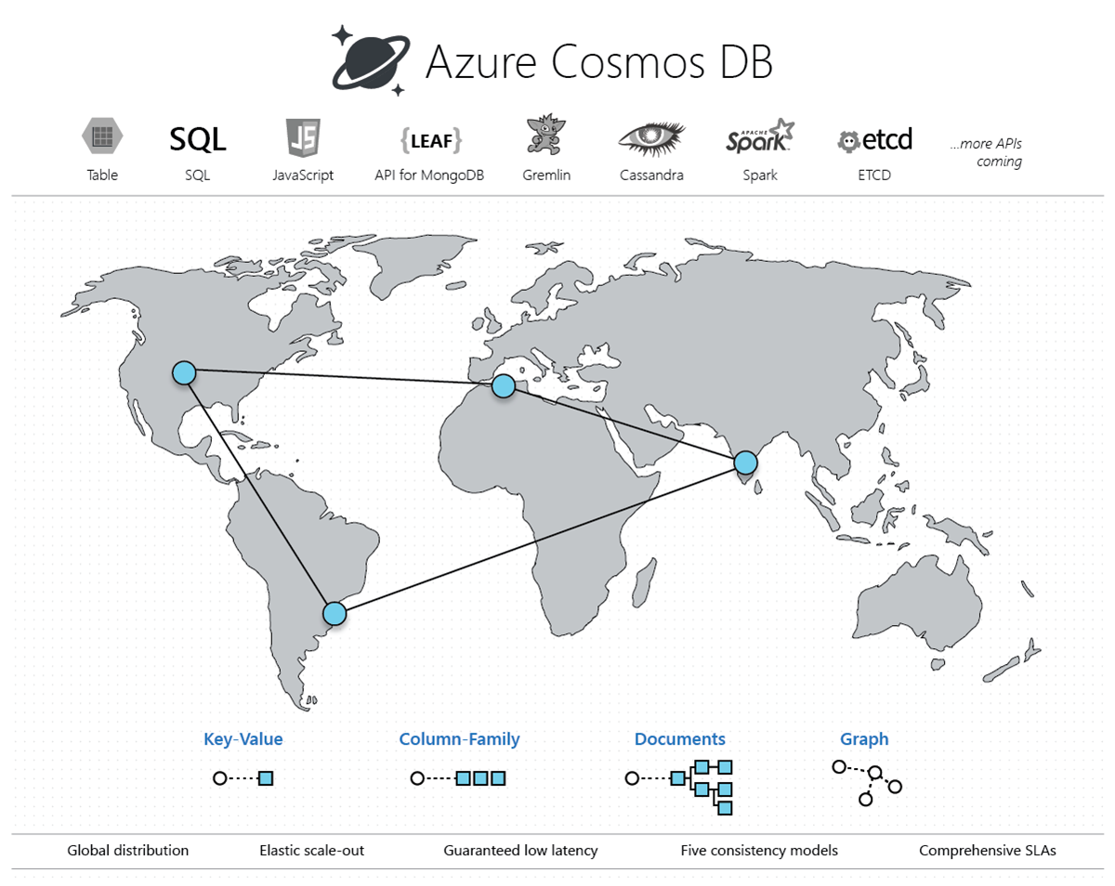
Cosmos DB

Slide 57
Exam AZ-303 Item Types

Slide 58

Multiple Choice

Slide 59
Repeated Scenario
You need to move an Azure VM to another hardware host.
Solution: You redeploy the VM.
Does this solution meet the goal?
Yes
No

Slide 60

Select and Place

Slide 61

Build List and Reorder

Slide 62

Active Screen/Fill in the Blank

Slide 63

Case Study

Slide 64






Performance-Based Lab

Slide 65
Microsoft Online Testing

Slide 66
Microsoft Online Testing Process
timw.info/online

Slide 67

Microsoft Online Testing Process

Slide 68

Microsoft Online Testing Process

Slide 69

Microsoft Online Testing Process

Slide 70

Microsoft Online Testing Process

Slide 71

Microsoft Online Testing Process

Slide 72

Microsoft Online Testing Process

Slide 73

Microsoft Online Testing Process

Slide 74
AZ-303 Exam Strategy
Focus your skills accordingly:
60 percent Azure portal
20 percent Azure PowerShell
10 percent Azure CLI
10 percent KQL
Expect performance-based labs, but be thankful if you don't see 'em

